Slide 1

Get Em’ Started
Job Openings, New Hires & Onboarding in Workday!
Facilitated by:
Deedee Castrodale
Alissa Price
Nolan Wade

Slide 2
Agenda:
Supervisory Organization
Job Requisition Updates
Hiring Updates
Onboarding Overview

Slide 3
Objectives:
Become familiar with new hire Updates and processes as they relate to the job requisition, hiring, and onboarding
Review where in workday particular items are found and processes performed

Slide 4
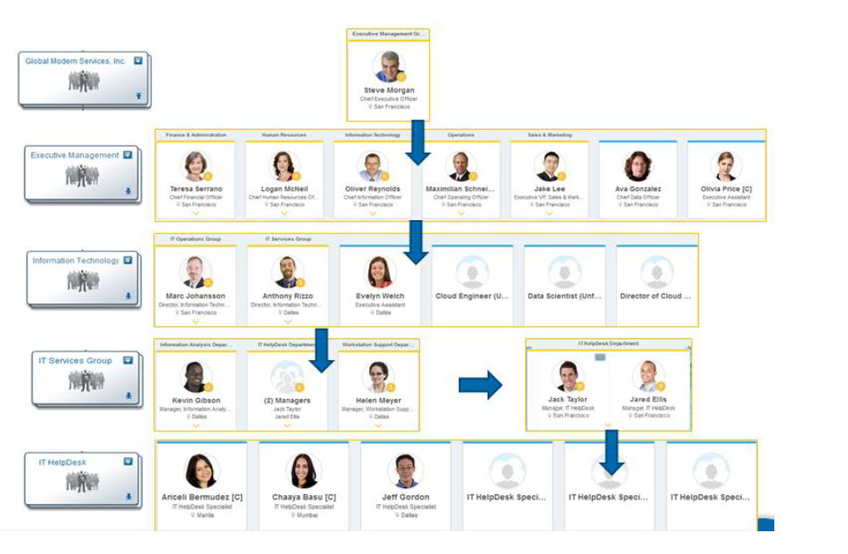
Supervisory Organization & Position Management:
The Primary Organizational Structure for Human Capital Management (HCM)
Every employee is hired into an approved, open position.
Every employee is hired into a position which sits within a supervisory organization
Workers are grouped and tracked within supervisory organizations.

Slide 5
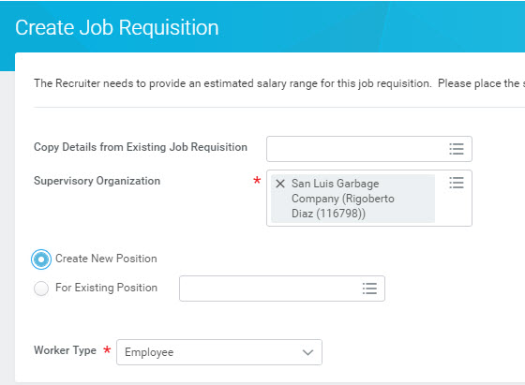
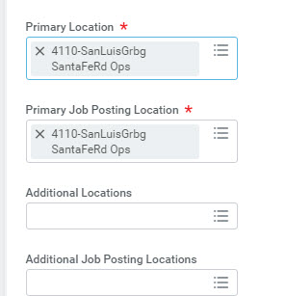
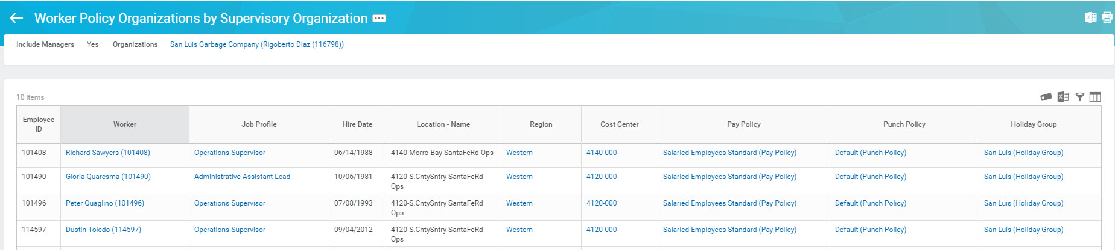
Job Requisition…Worker Policy Organizations by Supervisory Organization Report
When selecting the supervisory organization and location for the job requisition, The “Worker Policy Organizations by Supervisory Organization” report can be used to verify location and organization assignments.

Slide 6
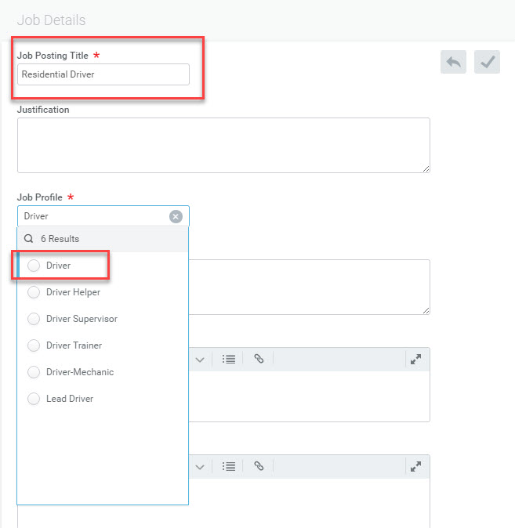
Job Requisition…Job Profile
Titles have been condensed to job profiles that cover a variety of job titles that managers can change in the business-card title.

Slide 7
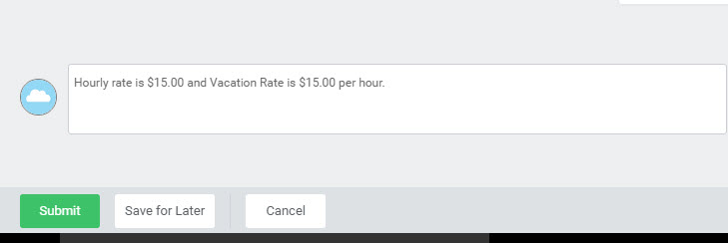
Job Requisition…Comment Box
Once the job requisition has been completed, the salary or hourly rate is documented in the comment box at the bottom of the page. In addition to the hourly information, please include the Vacation Rate as well. The Vacation rate is required for all hourly employees.
The hiring manager will also select the Vacation plan for hourly employees when proposing compensation.

Slide 8
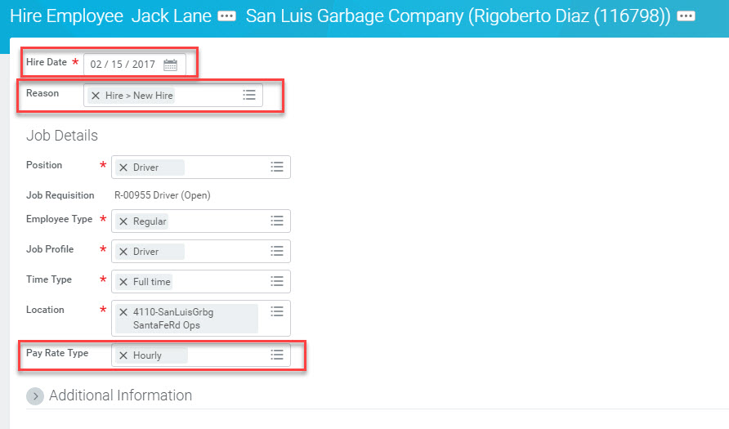
Hiring an Employee
The hire date must be accurate as that’s when Payroll will begin paying the employee. A reason for the hire must now be selected. Also, make sure the appropriate Pay Rate Type is selected.

Slide 9
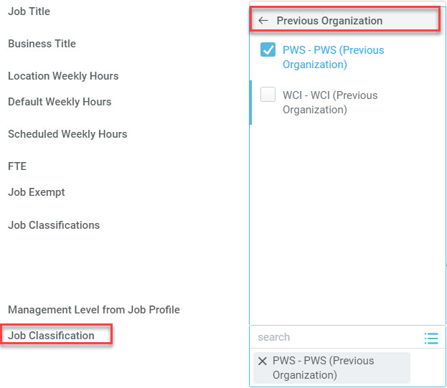
Hiring an Employee cont.…
Another required screen under Additional Information of the Job Requisition page is Job Classification. The Job Classification field requires a selection for Previous Organization. There are two options which are PWS (Progressive Waste) and WCI (Waste Connections). The selection in this field is based on legacy location which is extremely important as it drives benefit eligibility for the employee. The Previous Organization selection will need to be performed until June 1, 2017.

Slide 10
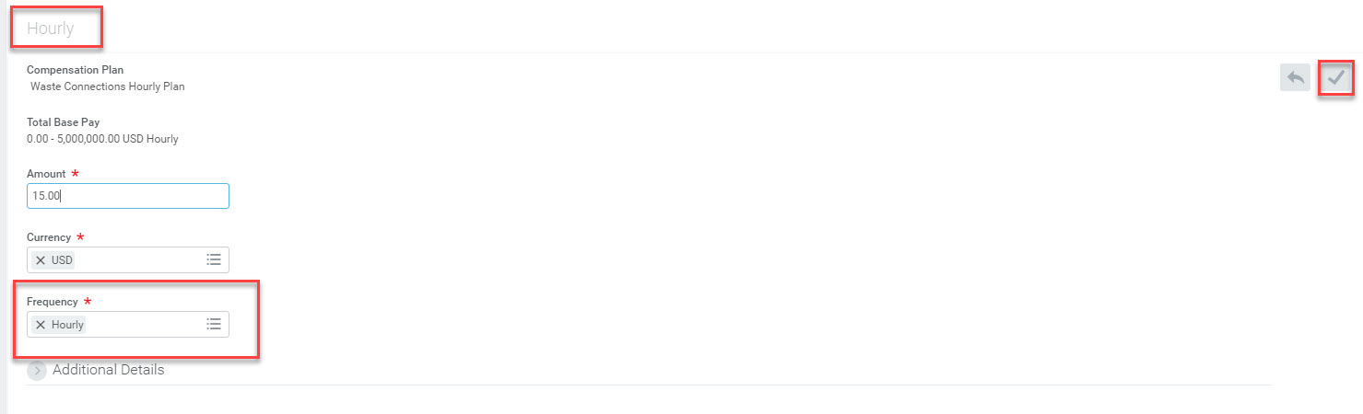
Hiring an Employee cont.…
The manager will propose compensation. Once done, click the Save icon.

Slide 11
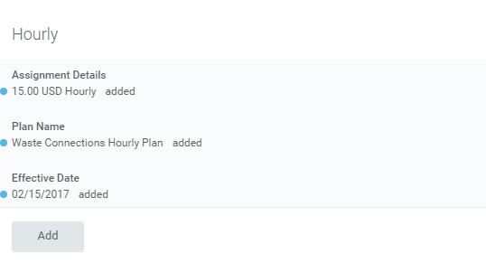
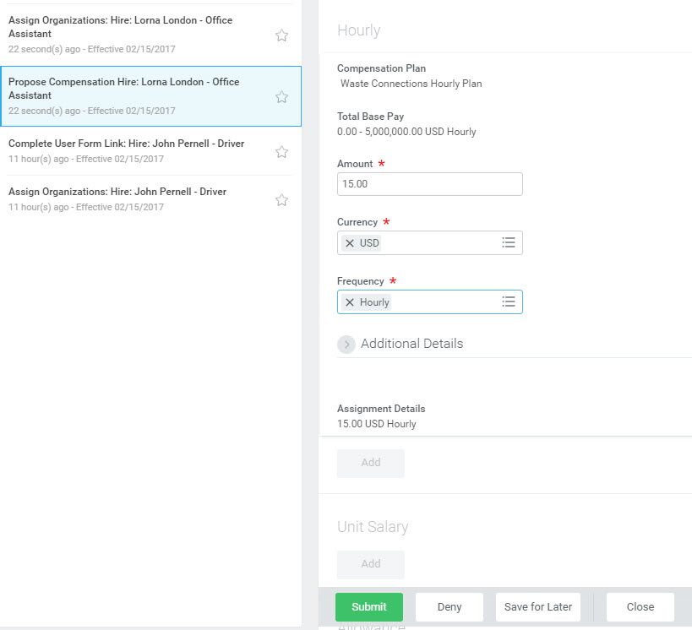
Hiring an Employee cont.…
The manager will then propose the Vacation Rate by clicking the Add button in the Hourly area, Select Vacation Rate from the drop-down menu and enter the amount, currency, and frequency information. Once done, click Submit.

Slide 12
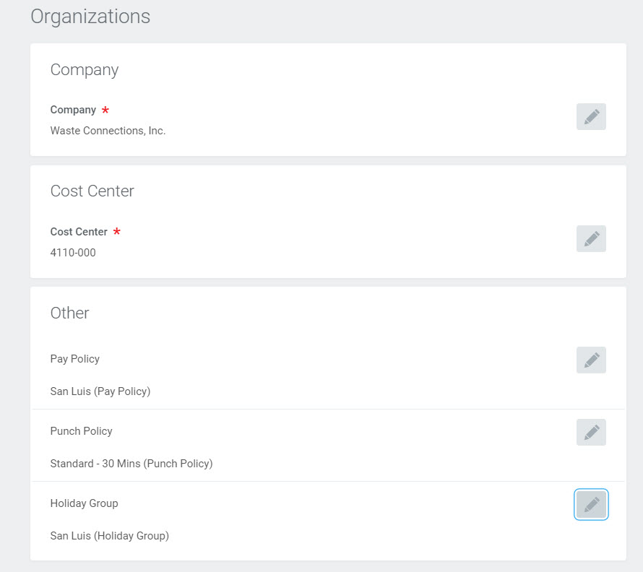
Hiring an Employee cont.…
The manager will then enter the organization assignments (Company, Cost Center, Pay Policy, Punch Policy, and Holiday Group.

Slide 13
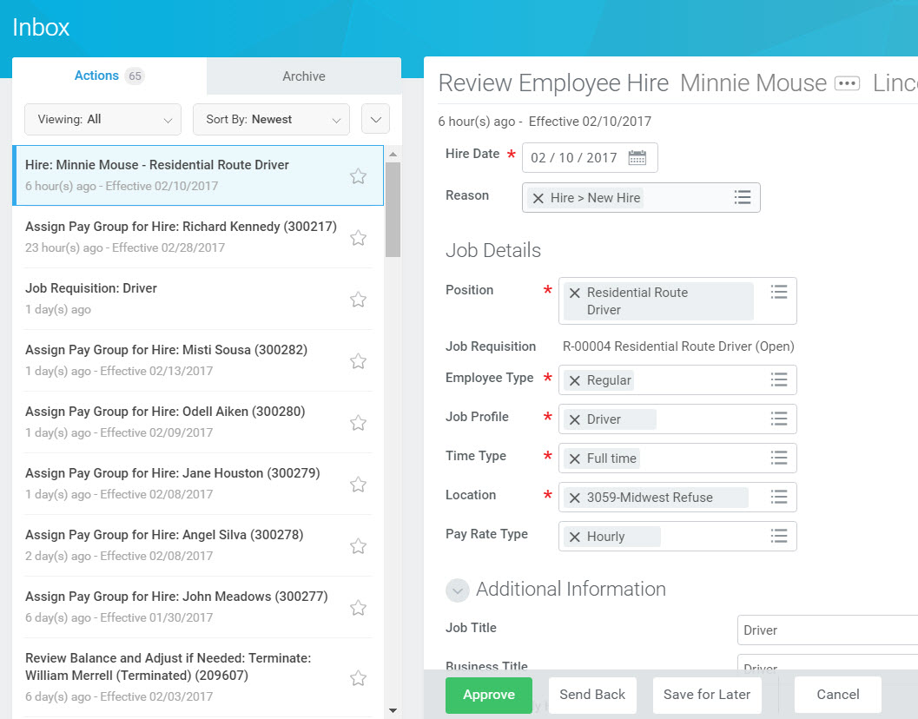
Hiring an Employee cont.…
The hire will then route to the Controller for review and approval. The Payroll Partner has also been added to that review and approval process. Once all approvers have approved, the employee will then begin the Onboarding process.

Slide 14
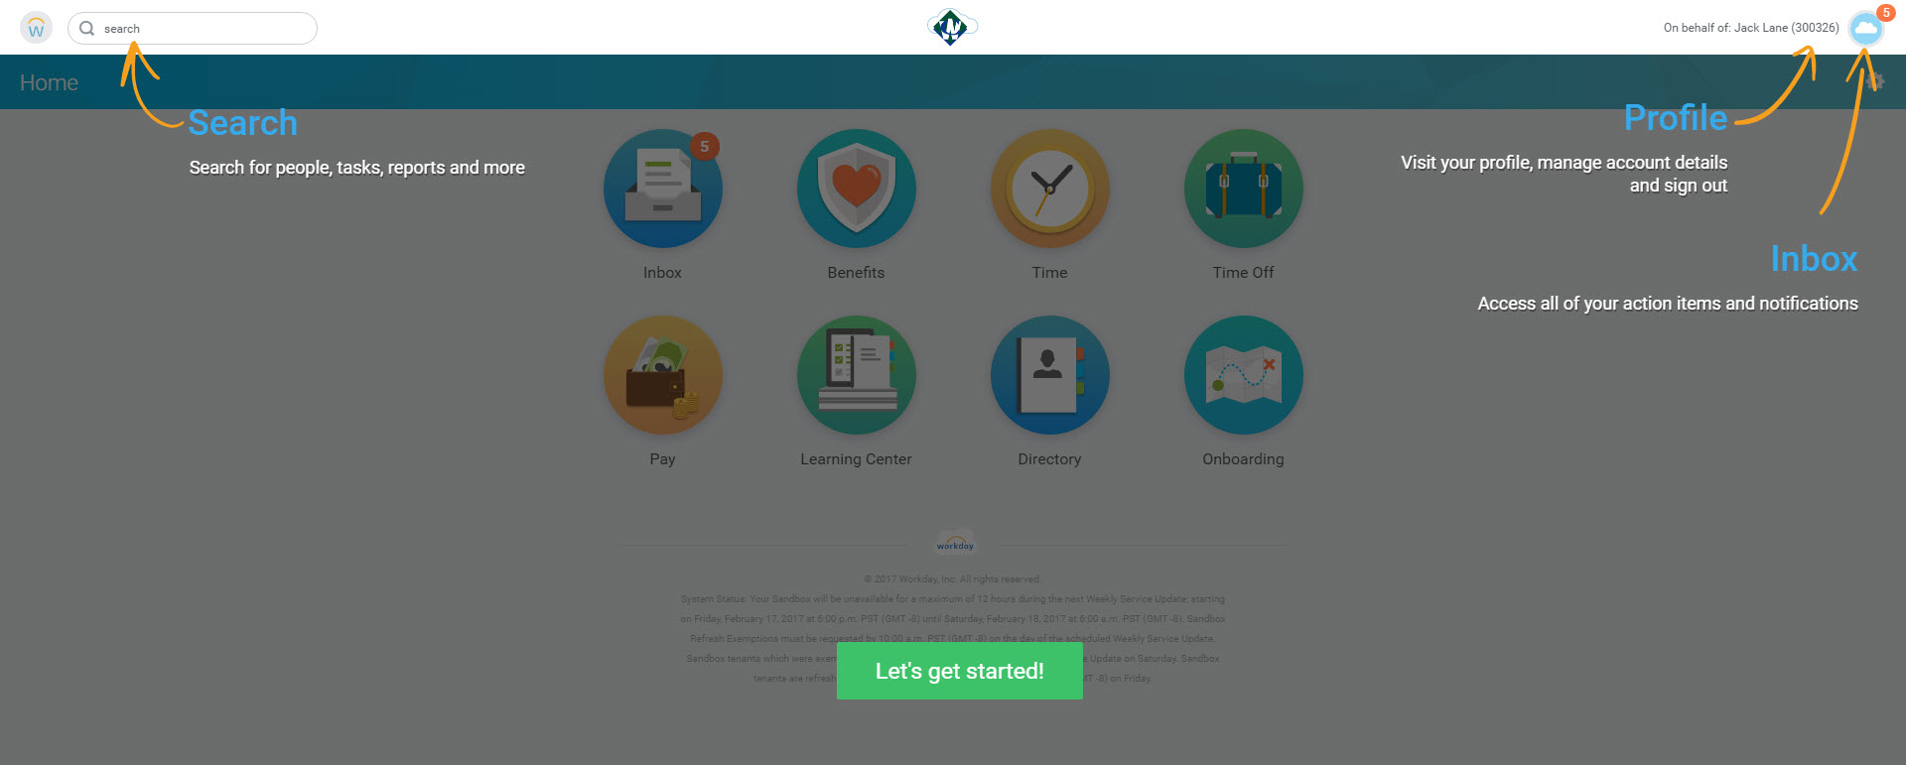
Onboarding
At initial login, arrows are pointing to the Search bar as well as the My Account button to access the Employee Profile and Inbox. Access the inbox by clicking the Inbox Worklet or the My Account button in the upper right corner. Both will reflect the number of tasks currently in the Inbox.

Slide 15
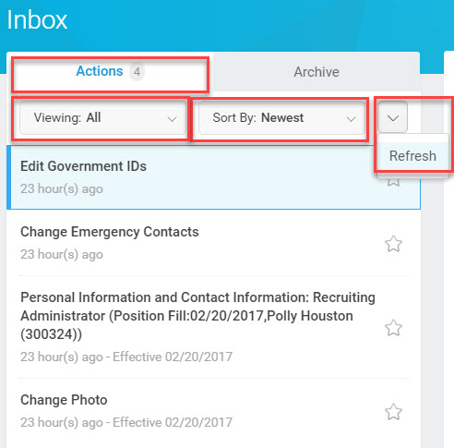
Onboarding…the Inbox
The inbox has two tabs: Actions tab and the Archive tab. The Actions tab:
Shows all tasks in the inbox.
Contains the Viewing filter which allows you to view all, favorite, overdue or special tasks and an Edit Filters button which can be used to make custom filters for your inbox.
Contains the Sort By filter which filters tasks from newest, oldest, or due date as well as a refresh button which can be used to manually update your inbox.
The Archive tab houses completed tasks.

Slide 16
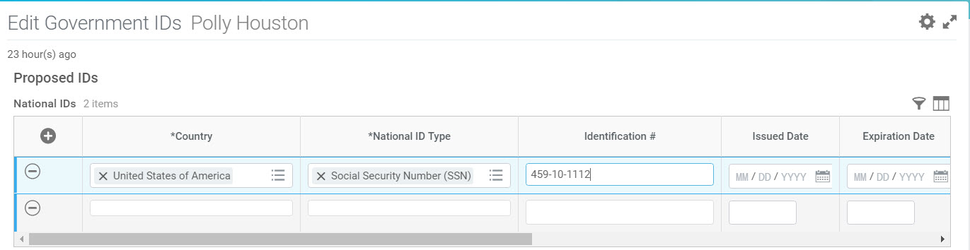
Onboarding…Edit Government IDs
The first task in the Onboarding process is to edit government IDs. The employee will add a new line and select the appropriate selections in each field. What is extremely important to remember here is that a Pay Group cannot be assigned unless the employee submits his/her social security number. Without it, the employee will not be paid or receive his/her benefits.

Slide 17
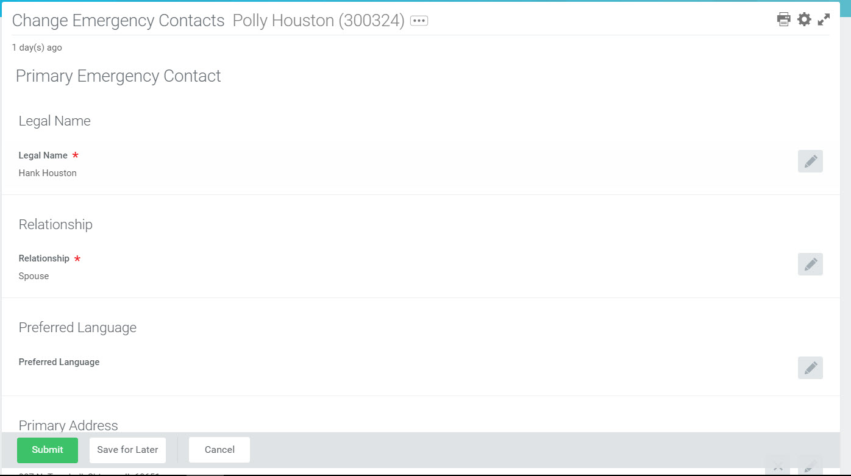
Onboarding…Change Emergency Contacts
Employee to submit all required and applicable fields of information regarding emergency contact.

Slide 18
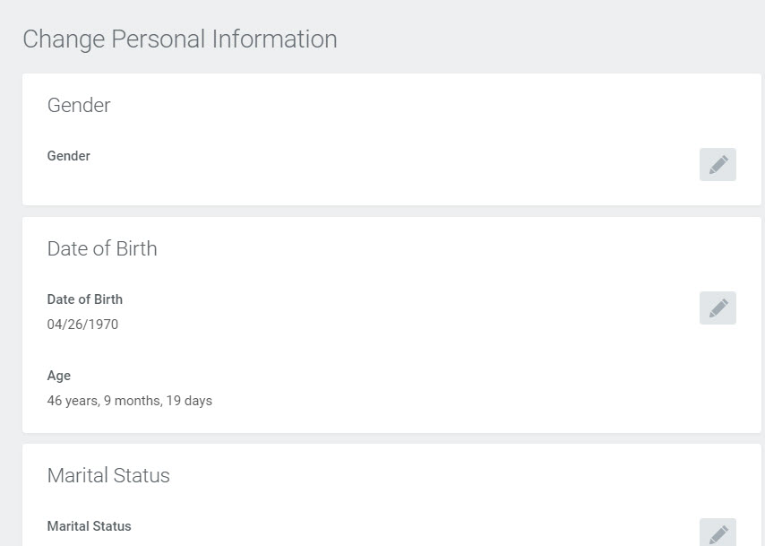
Onboarding…Personal Information and Contact Information
The employee is required to complete the fields for address, gender, and date of birth because that information is required for the employee to receive benefits.

Slide 19
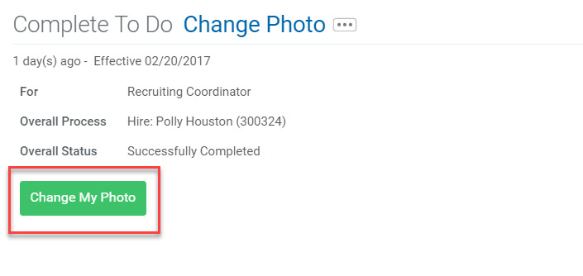
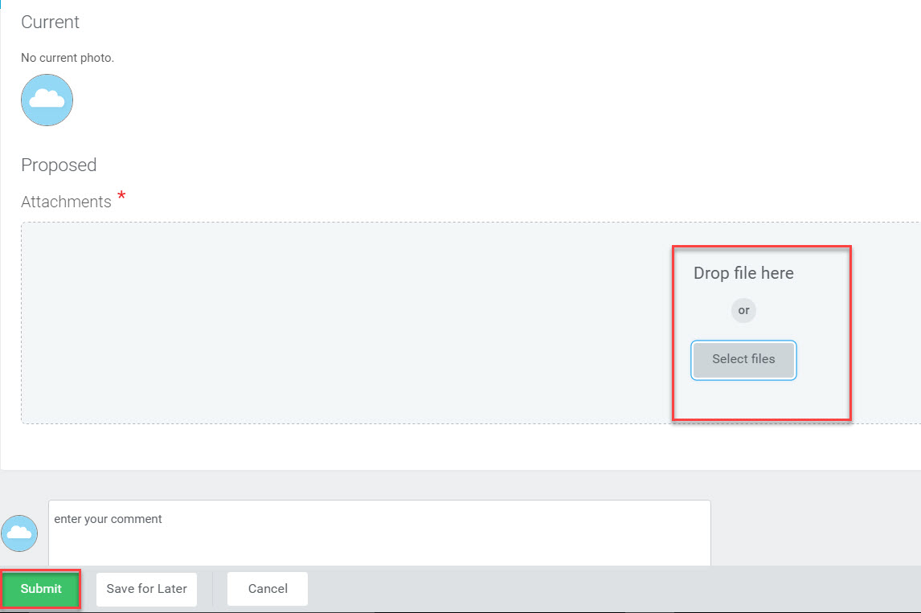
Onboarding…Change Photo
Employee clicks on the Change My Photo button and Proposed screen opens allowing the employee to drag or upload a photograph.

Slide 20
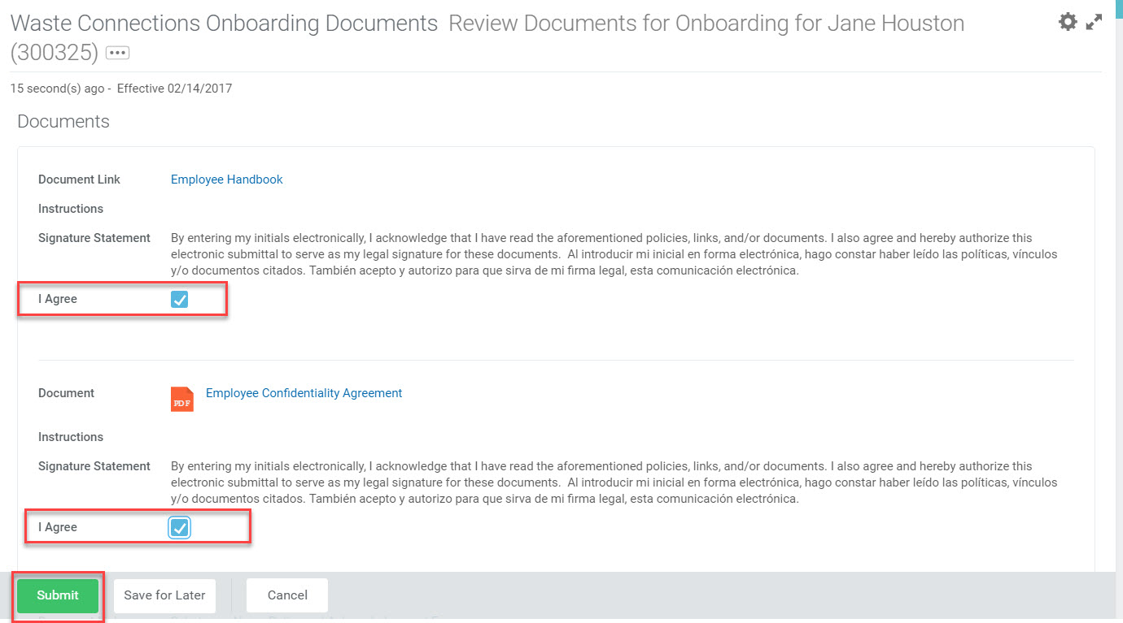
Onboarding…Waste Connections Onboarding Documents
The employee is to open and review each document. When done, click on the I Agree checkbox. If the employee is working in a state that requires its own onboarding documents, he/she will receive an inbox notification to complete them in the same manner as the previous onboarding documents.

Slide 21
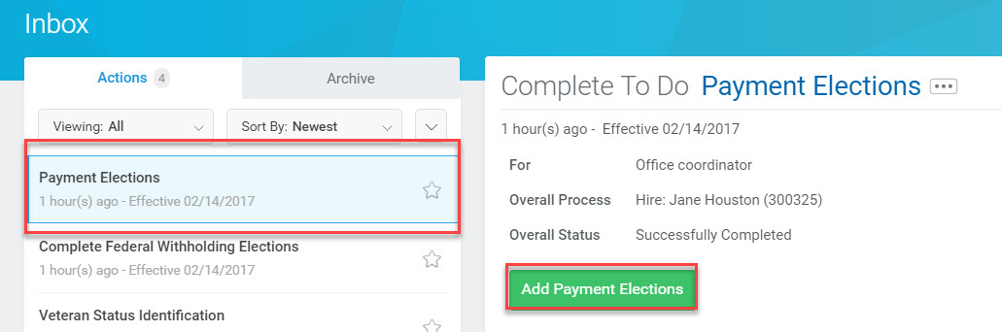
Onboarding…Payment Elections
Employees will click Payment Elections to choose how they would like to receive their paychecks.

Slide 22
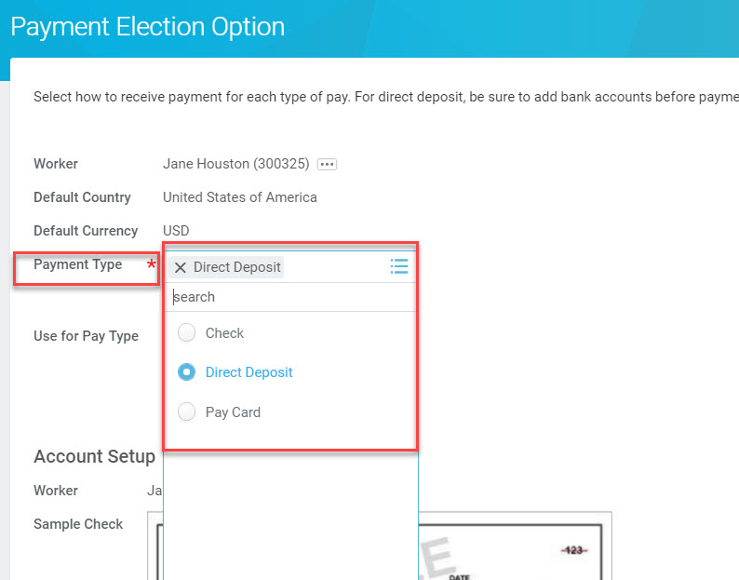
Onboarding…Payment Elections cont..
Employee will first select payment type and choose if his/her pay should be given in the form of a check, direct deposit, or pay card.

Slide 23
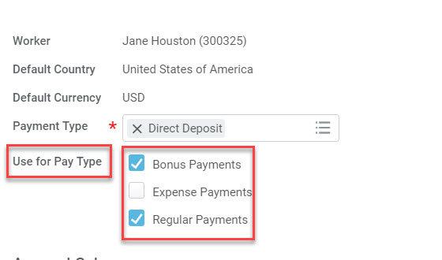
Onboarding…Payment Elections cont..
Employee will access Use for Pay Type to determine what the sources of payment are for the payment election. He/she will click and check Bonus Payments, Expense Payments, and/or Regular Payments.

Slide 24
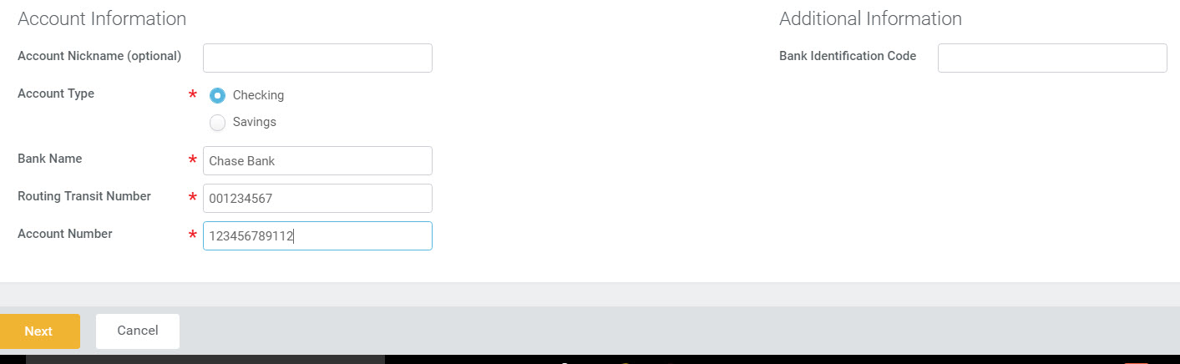
Onboarding…Payment Elections cont..
Employee enters all required and applicable account information

Slide 25
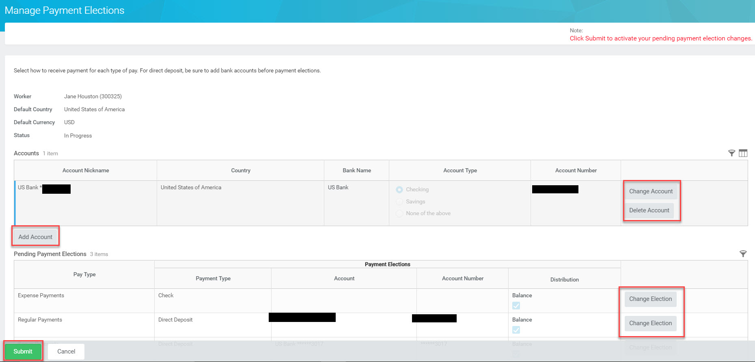
Onboarding…Payment Elections cont..
The Manage Payment Elections page allows the employee to submit or make changes to current elections.

Slide 26
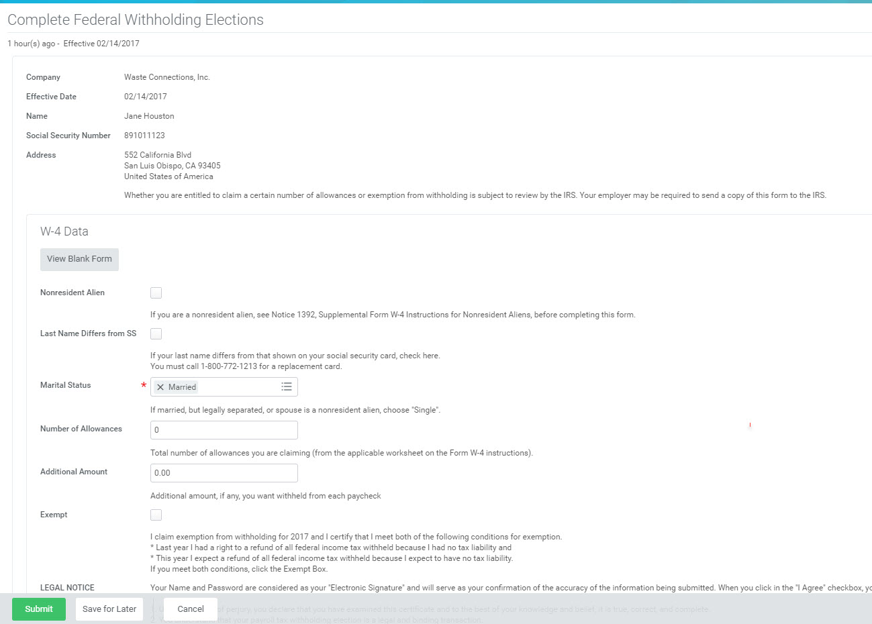
Onboarding…Federal Withholdings
Employee enters all required and applicable information.

Slide 27
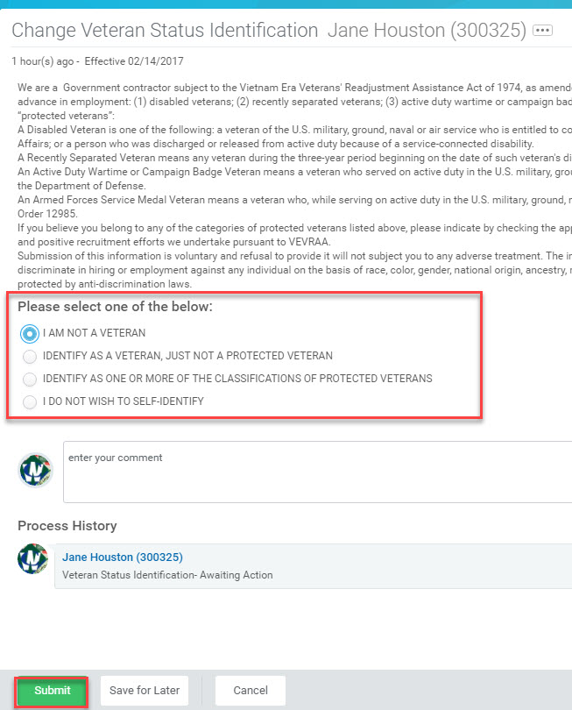
Onboarding…Payment Elections cont..
Employee will enter all applicable information.

Slide 28
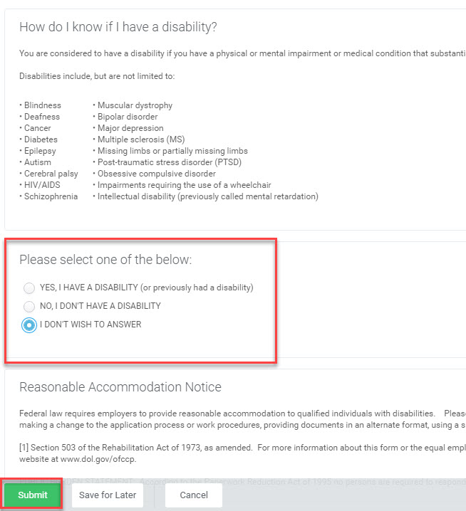
Onboarding…Disability Self Identification
Employee will select the most appropriate option.

Slide 29

Questions???

Slide 30

Resources:
Job Aids Currently Available in the Learning Worklet:
Workday Overview for Recruiters
Employee Onboarding in Workday

Slide 31
THANK YOU!!

